Slide 1
Blockchain

Slide 2
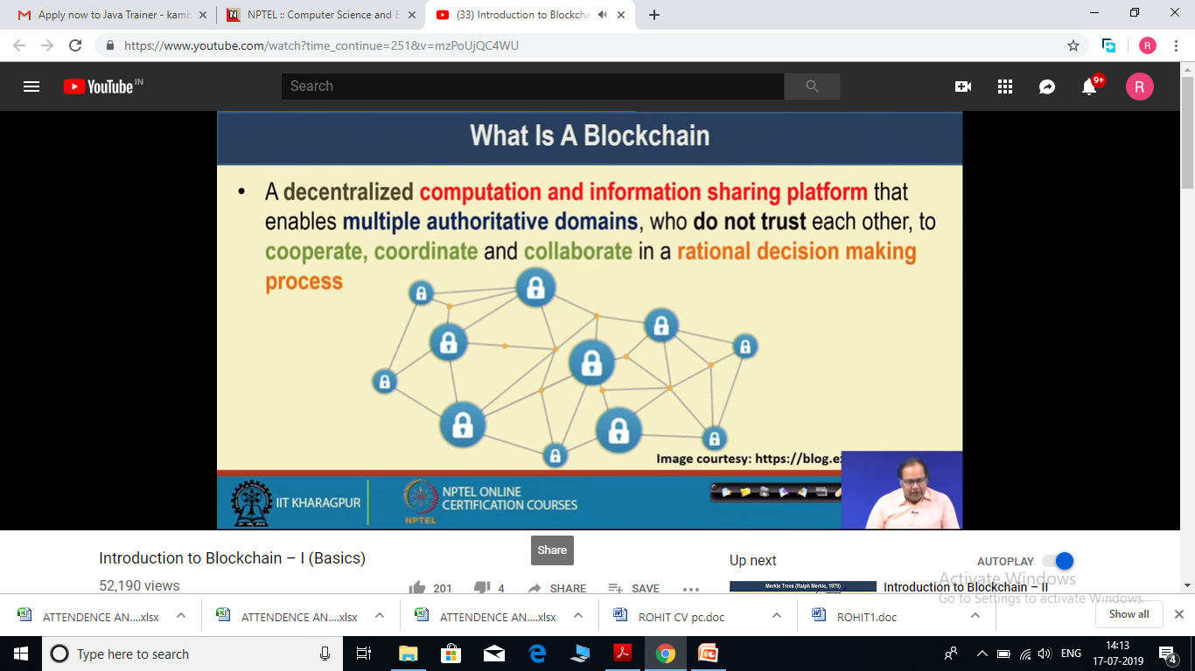
Introduction
A blockchain is a growing list of records, called blocks, that are linked using cryptography.[ Each block contains a cryptographic hash of the previous block, a timestamp, and transaction data
A blockchain is essentially a digital ledger of transactions that is duplicated and distributed across the entire network of computer systems on the blockchain. Each block in the chain contains a number of transactions, and every time a new transaction occurs on the blockchain, a record of that transaction is added to every participant’s ledger.
Once a transaction is stored in the ledger, It cannot be changed by anyone later. i.e. Records are unalterable.
Blockchain provide a solution for organisations (peoples), who wants to work together to run their businesses efficiently, but do not trust each other.

Slide 3
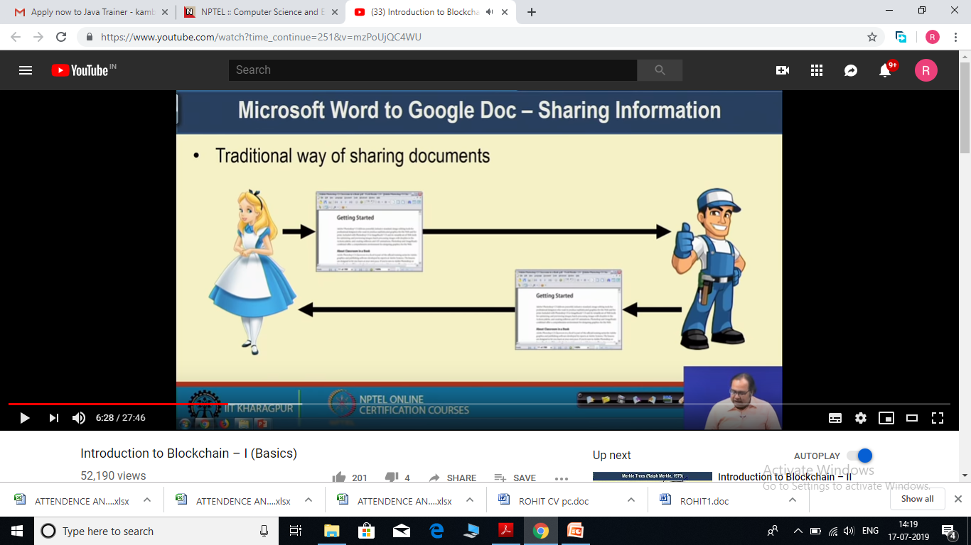
How Blockchain is useful
Alice wants to share some document with Bob, She writes the content and share with Bob, Bob update content and share with Alice.
In this architecture style there will be multiple disadvantages –
1 – Both are not able to access data simultaneously.

Slide 4
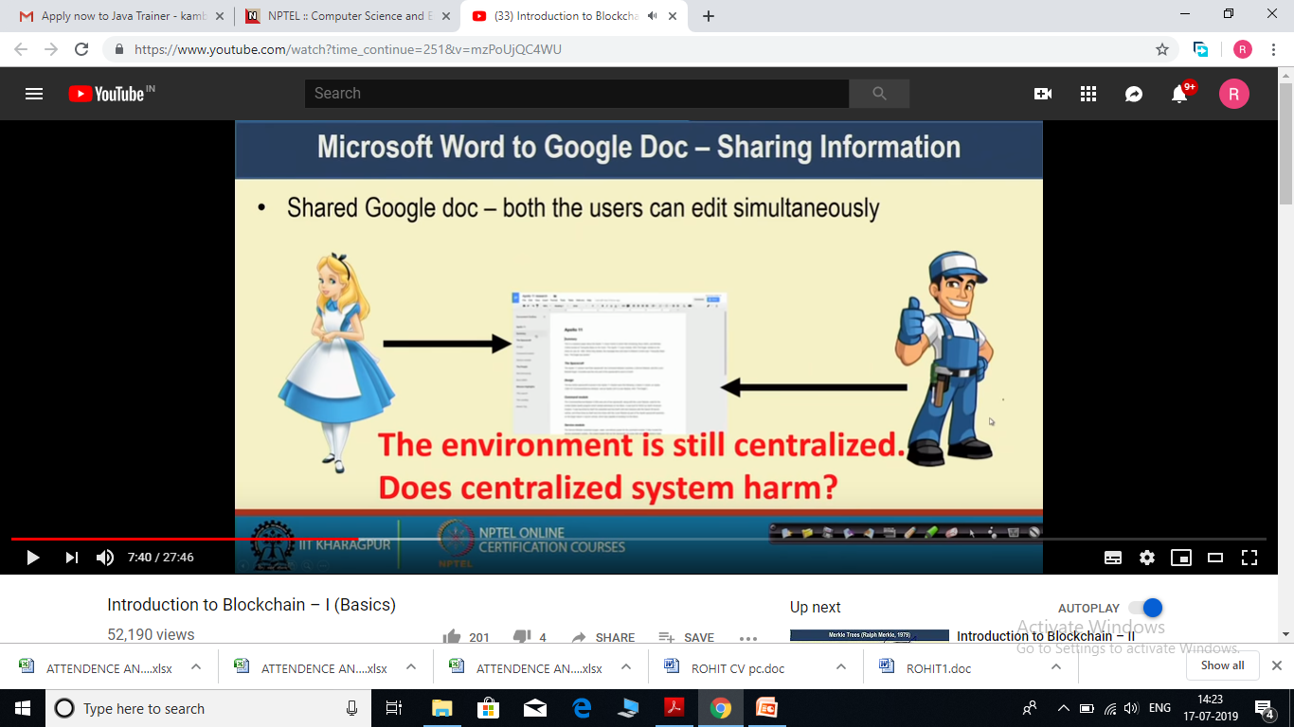
Next move to the Centralized architecture style – (like Google doc)
Now both can access the data simultaneously, but still environment is centralized. It can have single point of failure problem.

Slide 5
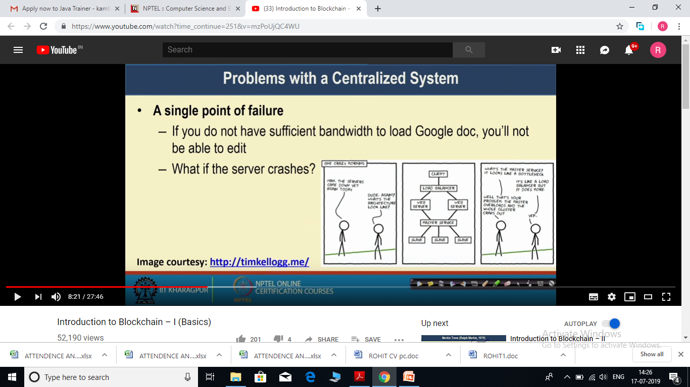

Slide 6
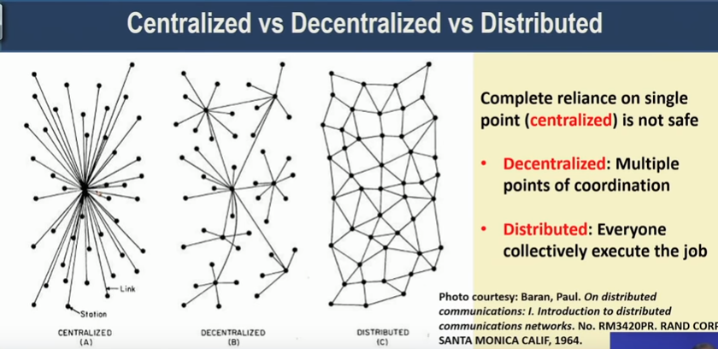
Centralized Architecture – There is a centralized coordinator system, if any node wants to convey some information to some other node, first it pass it to central coordinator, then from central coordinator it goes to recipient node.
So if this centralized coordinator stops working there will be no other ways to communicate for other nodes.
So we move to Decentralized System architecture.

Slide 7
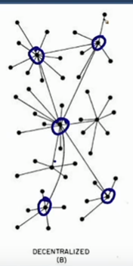
Decentralized Architecture – Here we have few coordinators and these coordinator cooperate with each other and individual nodes connected to these coordinators.
If any coordinator fails, individual nodes can connect to other coordinator.(b/c of cooperation among coordinators).
So in this architecture we can tolerate some coordinator failure, until n/w failure. If n/w fails, lets say n/w gets partition then these node will not be able to coordinate with each other.
To solve this problem we move to the Distributes architecture.

Slide 8
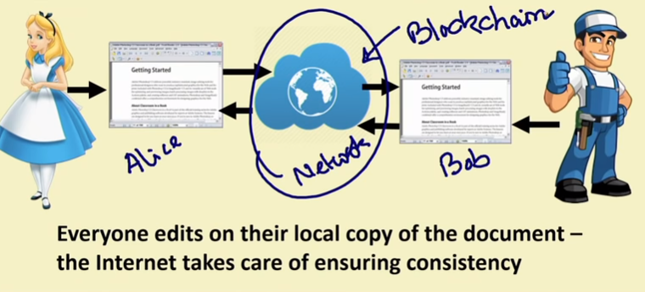
Distributed Architecture – All nodes participate in information sharing or computation process.
Blockchain is a technology that enables you to use Distributed architecture style to share the information among different participants in your business process.
So the ideal solution to share information b/w Bob and Alice will be –

Slide 9
Here both Bob and Alice will update their own copy of doc, and it is the responsibility of Blockchain n/w to maintain consistency among both copies.

Slide 10
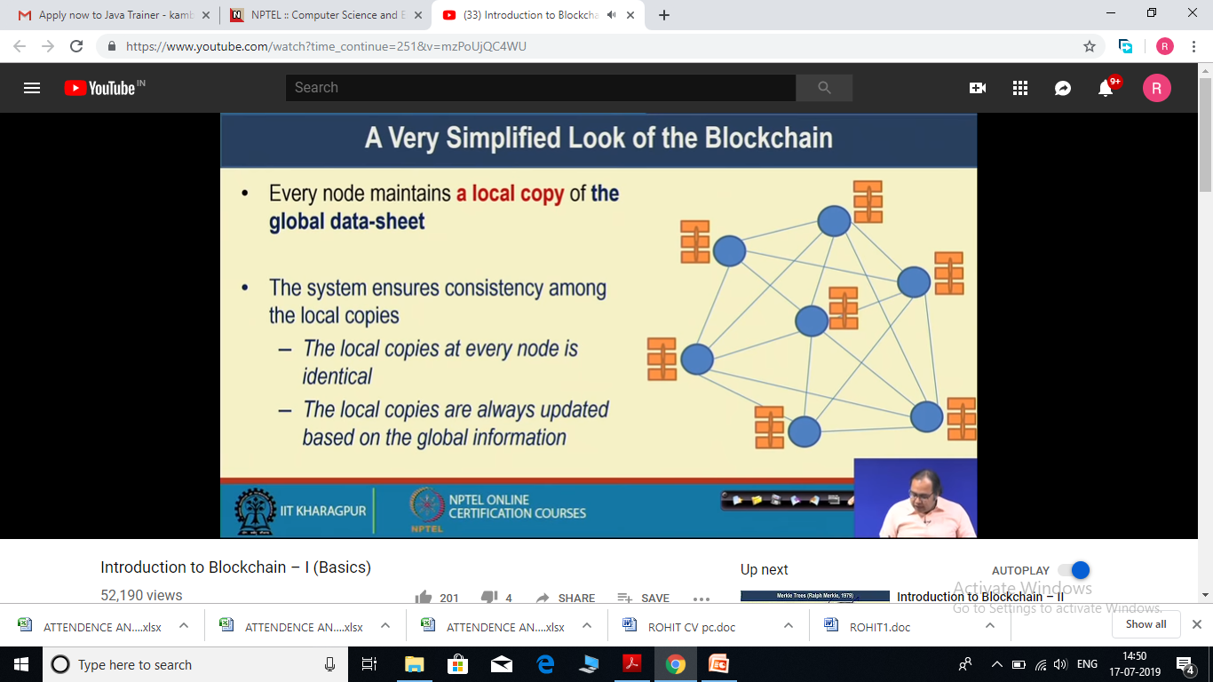
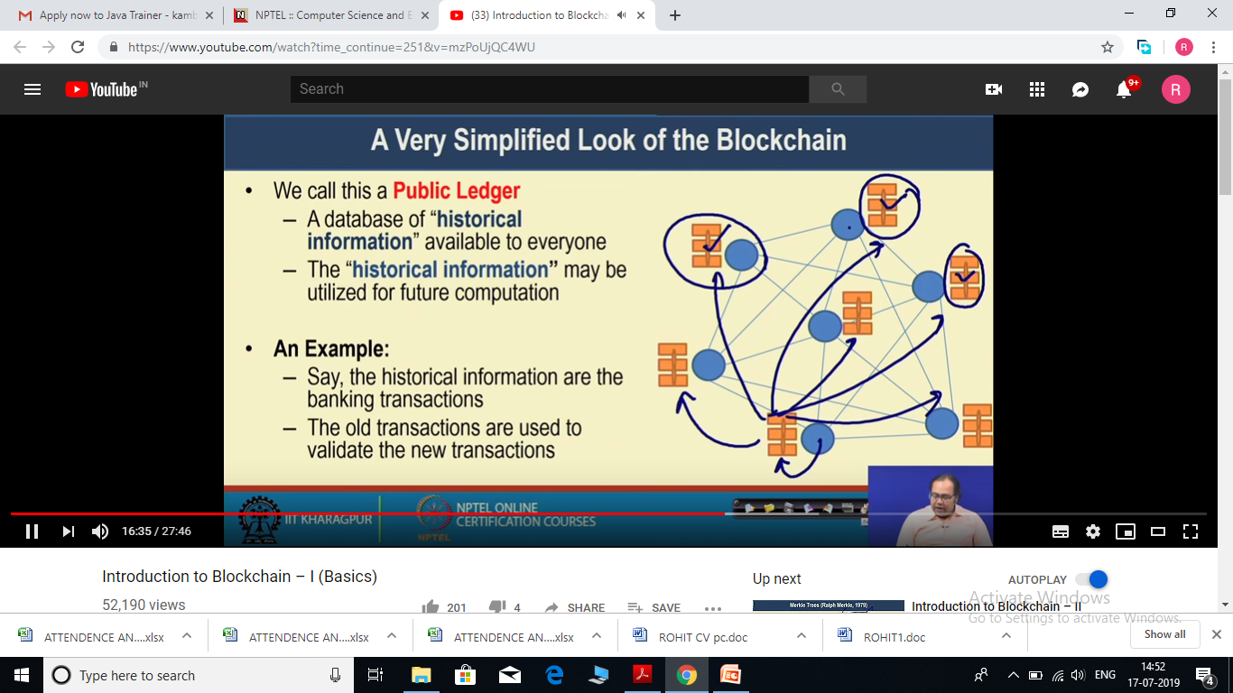

Slide 11
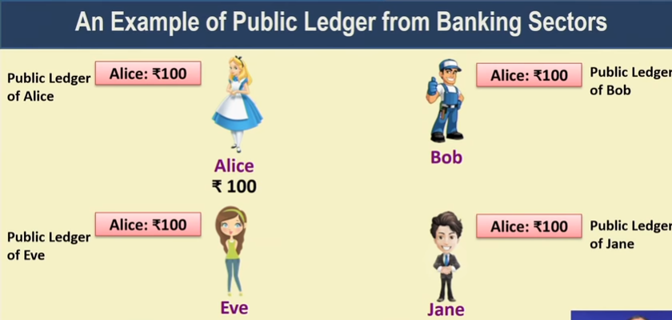
Lets suppose that initially Alice has 100 rs.
So everyone ledger will be updated by Alice 100 rs.

Slide 12
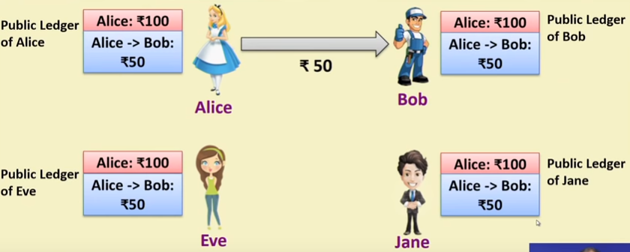
Now Alice gives 50 rs to Bob. In that case we add a new transaction in public ledger, that need to be updated with all participant public ledger.
Then Bob makes payment of 30 rs to Eve, Again this transaction will be added to ledger.

Slide 13
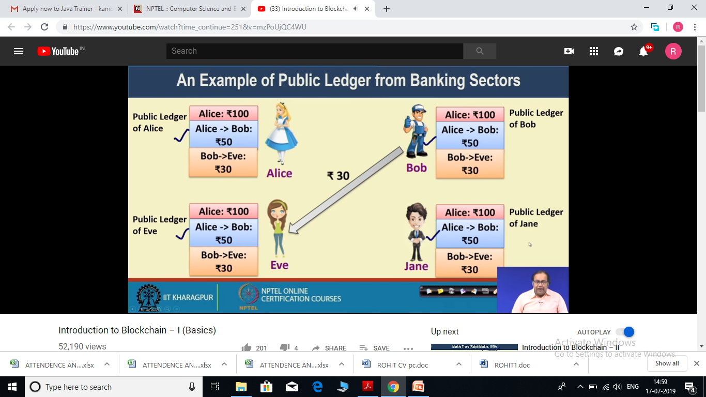
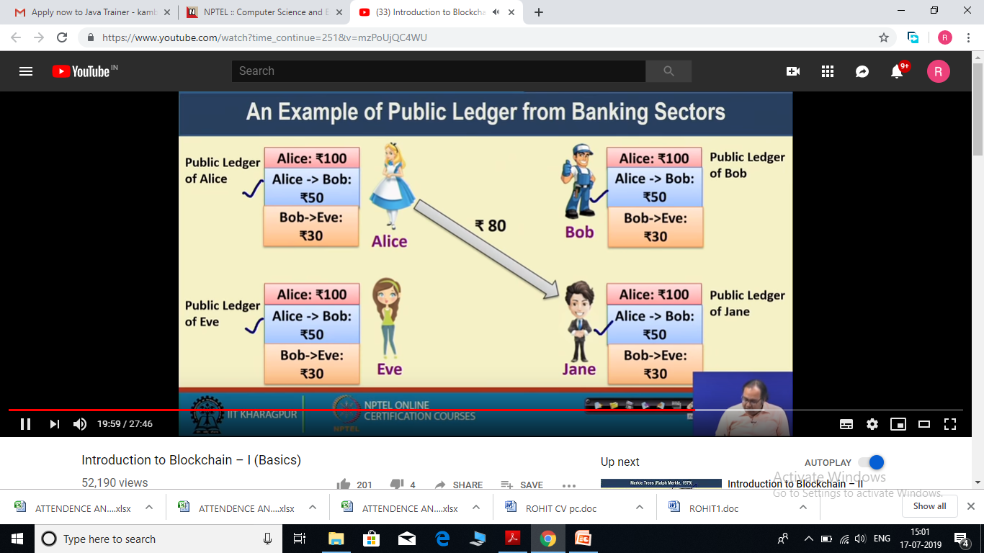
Now lets say Alice wants to make a payment of 80 rs to Jane.

Slide 14
But by looking at the ledger we already know Alice have only 50 rs in hand.
That means this particular transaction is not valid and all the parties involved know this. So this transaction will be blocked and not updated in ledger.

Slide 15
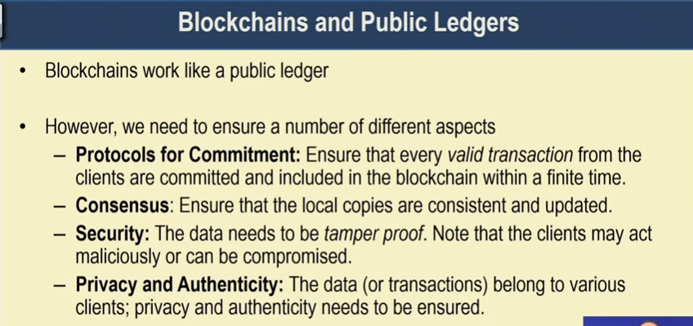
Protocol for Commitment – Whenever someone making a new transaction, during that time you need to ensure, if this transaction is valid, it will get committed to the existing public ledger, otherwise that entry should not be there in ledger.
So there should be a mechanism for validity checking for every incoming transaction. And based on that validity checking you should be able to either accept or reject the transaction.

Slide 16
Consensus – It is a very important aspect of Blockchain. Blockchain does not have any centralized system like bank to maintain consistency. So it is important to make sure that local copy each participant have are consistent (identical or similar) with each other.
Security – Security need to be ensure that if any participant broadcast a malicious information, then other participant be able to understand that it is a false information.
Privacy – There will be various clients in blockchain n/w, they will have several private data, the privacy and authenticity of that data is also need to be ensure.

Slide 17
